Slide 1
NumPy Tools for Data Science
NumPy, vectorization

Slide 2
Upcoming Assignments
Reading: 2.1 – 2.5
DS Lab 2: Vectorization due Jan 17th 11:59 pm

Slide 3
Today
Tim Kapp
tkapp@byu.edu
TMCB 2254 — By Appointment
NumPy Broadcasting
Array Slicing
Linear Algebra with np
Vector vs Non-Vector Operations
Teaching Assistants:
Kayla Ou -- ouj22@byu.edu
Spencer Hales — srhales@byu.edu
Spencer Marshall — sm892@byu.edu
Michael Jensen — mikelj01@student.byu.edu
Toby Alley — talley0@byu.edu
West View Building (WVB 1151)
Office Hours: See Syllabus on Canvas

Slide 4
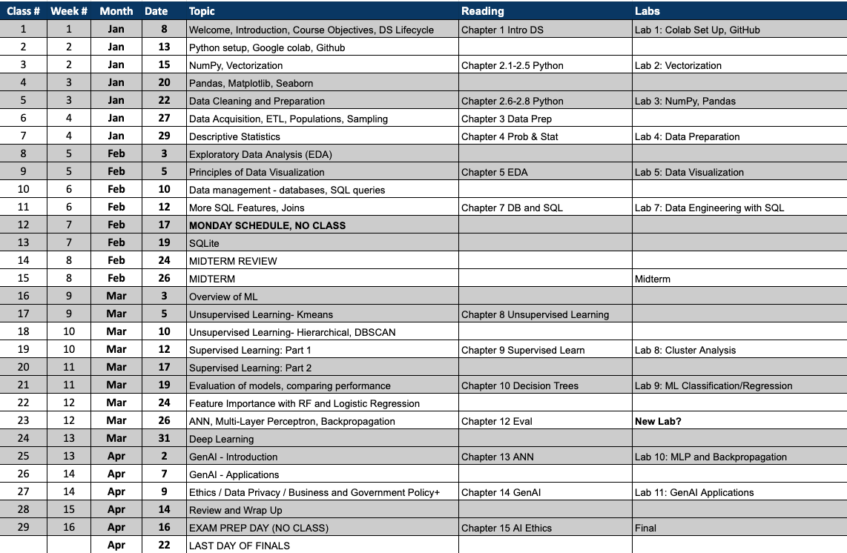


Slide 5
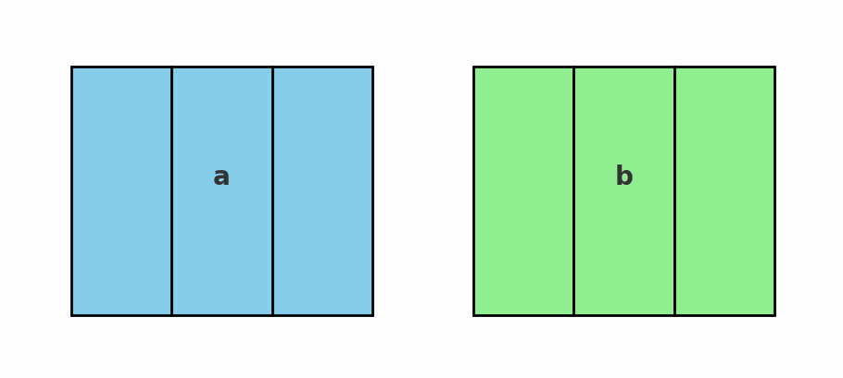
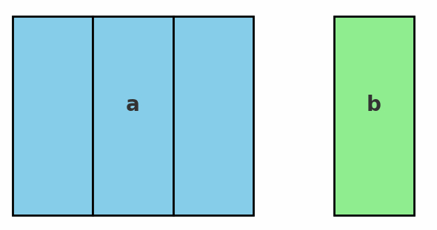
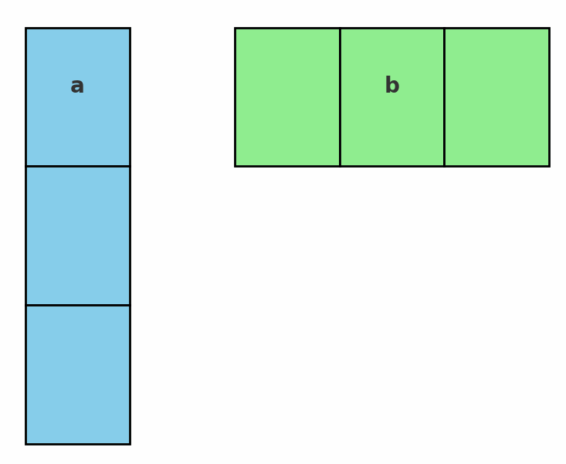
NumPy Array Broadcasting
Broadcasting allows NumPy to perform operations on arrays with different shapes by “virtually” expanding dimensions
Compatibility Rules:
  Dimensions have the same size, or
  One of the dimensions has a size of 1.
If compatible, replicate the smaller dimension array to match the larger array.
If one array has fewer dimensions, prepend 1s to its shape to match
If, after alignment, any mismatch remains, then broadcasting fails.

Slide 6
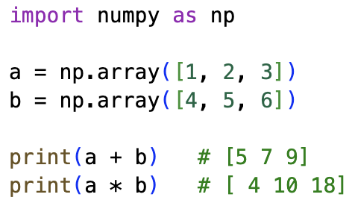
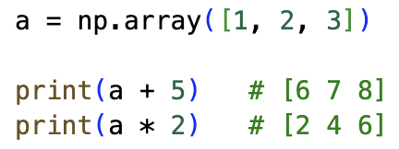
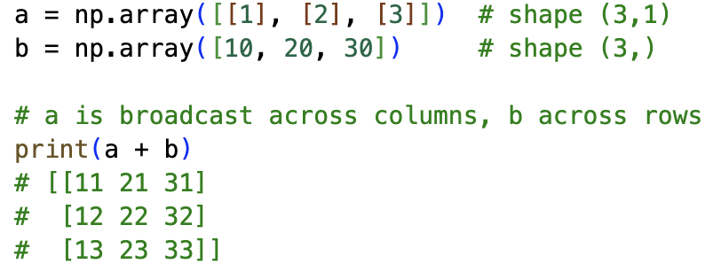
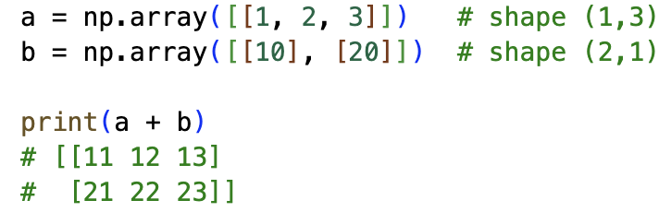
NumPy Array Broadcasting
1. Same Shape → Elementwise Operations
If two arrays have the same shape, operations are applied element by element.
2. Scalar with Array
A scalar is treated as an array of the same shape as the other operand.
3. Different Shapes with Compatible Dimensions
Broadcasting works when dimensions are equal or one of them is 1.
4. Automatic Expansion of Size-1 Dimensions
If one array has a dimension of size 1, NumPy stretches it to match the other.
5. Broadcasting Fails if Incompatible
If shapes don’t align according to the rules, NumPy raises an error.

Slide 7
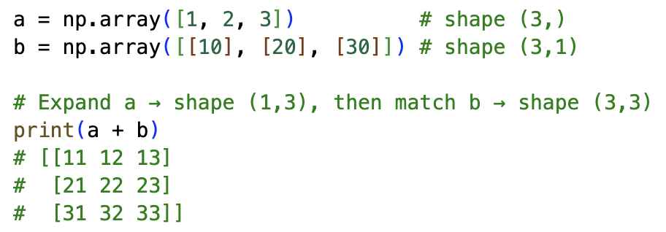
NumPy Array Broadcasting
6. Broadcasting with Higher Dimensions
NumPy compares dimensions from right to left. Missing dimensions are assumed to be 1.
✅ Summary of Broadcasting Rules
NumPy compares array shapes from right to left.
Two dimensions are compatible if they are equal or one is 1.
If one array has fewer dimensions, prepend 1s to its shape.
If, after alignment, any dimension mismatch remains, broadcasting fails.

Slide 8
NumPy Array Slicing
The Array slicing in NumPy is a way to extract a portion (subset) of an array by specifying start, stop, and step positions along one or more dimensions.
basics: start: stop: step
Slices use half-open intervals: start inclusive, stop exclusive.
Any part can be omitted; defaults are start=0, stop=len, step=1.
Negative indices count from the end; negative step reverses direction.
Slicing returns a view (no data copy) when possible.
Go to short_numpy_array_slicing_guide_exercises.ipynb

Slide 9
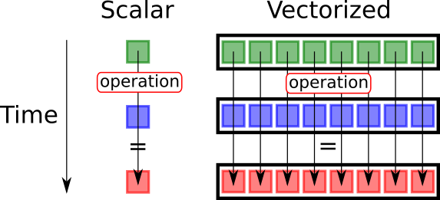
non-vectorization vs Vectorization in Python/NumPy
Non-vectorized approach:
You write explicit loops in Python (e.g., for loops) to process elements one by one.
This is straightforward but slow, because each iteration runs in Python’s interpreter, which has a lot of overhead.
Vectorized approach:
You use NumPy, Pandas, or similar libraries that implement operations in optimized C/Fortran code under the hood.
The operation applies to the whole array at once, avoiding explicit Python loops.
Much faster and more concise.

Slide 10
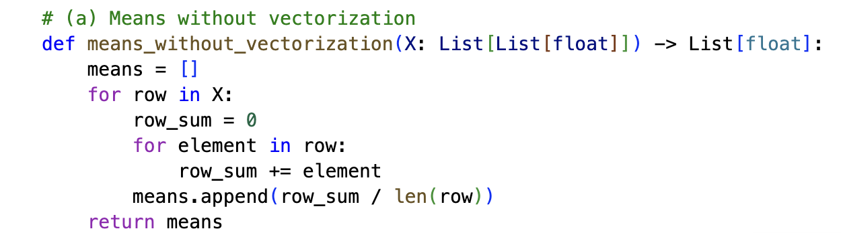
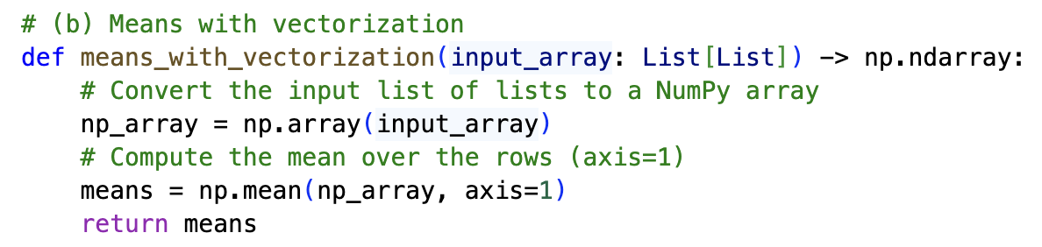
non-vectorization vs Vectorization in Python/NumPy
np_array = np.array(input_array): It first converts the input list of lists (input_array) into a NumPy array. This is crucial for utilizing NumPy's vectorized functions.
means = np.mean(np_array, axis=1): This is the core of the vectorization. np.mean() is a NumPy function that calculates the mean of array elements. The axis=1 argument specifies that the mean should be computed along the rows (axis 0 is for columns).
return means: The function returns the resulting NumPy array containing the mean of each row.
When you perform an operation with axis=1, you are telling NumPy to perform the operation along the columns
Notes:
When you perform an operation with axis=1, you are telling NumPy to perform the operation along the columns, which effectively collapses the columns and results in a value for each row.
Think of it this way:
axis=0: The operation is applied down each column. The result will have a value for each column.
axis=1: The operation is applied across each row. The result will have a value for each row.
So, when you use np.mean(np_array, axis=1), you are calculating the mean of all the elements across each row, giving you the average for each row.

Slide 11
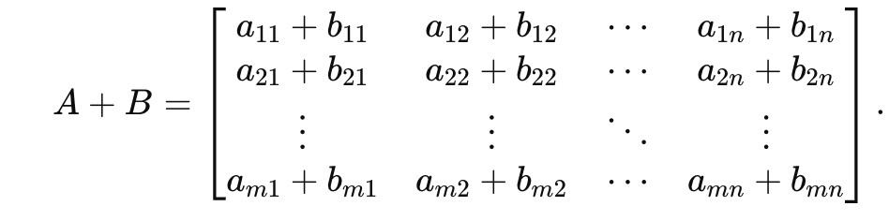
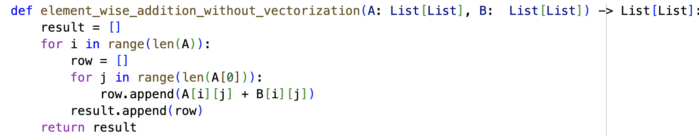
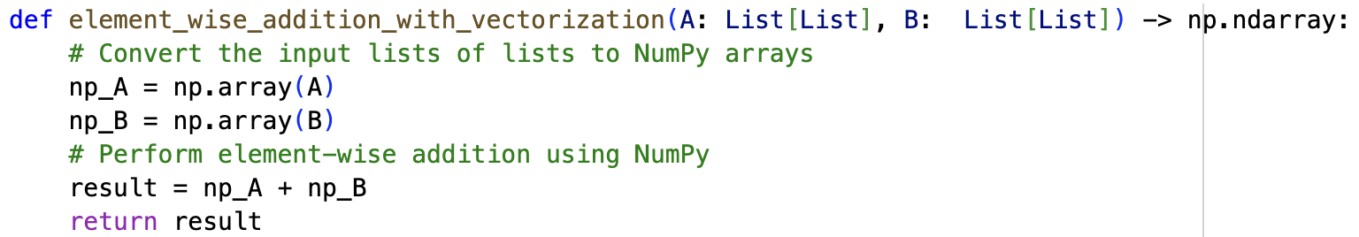
non-vectorization vs Vectorization in Python/NumPy

Slide 12
Key Linear Algebra Operations with NumPy
Matrix operations
np.dot() — Dot product
np.matmul() — Matrix multiplication
np.transpose() — Transpose of an array
np.reshape() — Reshape an array

Slide 13

Group Challenge: Mean Squared Error
Breakdown of MSE calculation without and with vectorization
Write a function using NumPy to implement mean squared error between two arrays, each of size n
Use the np.square function and the .mean() method.
Break down the problem into calculating the squared error first, then find the mean of that squared error.

Slide 14
Python Code Examples
Introduction to NumPy: https://colab.research.google.com/drive/1F0SNYtuqqcJHzrjYXX62KGGoc-v-VePl#scrollTo=H5Gk682T7FQI
Mean Squared Error Details: https://colab.research.google.com/drive/1nzF3azRRvtFONjigEQ1O2qzr5AGCMX_U#scrollTo=Cq9_xFg9zgIP
DS Lab 2: Vectorization Hints: https://colab.research.google.com/drive/1m3T5CZOsrUdI5b4rnDDm4vekRrTL_hmg

